Slide 1
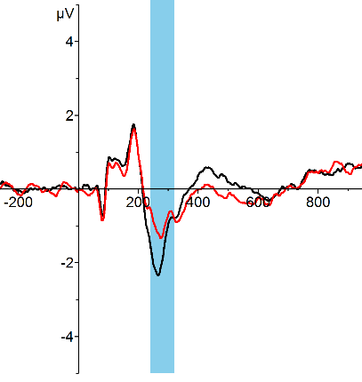
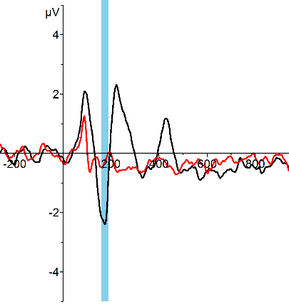
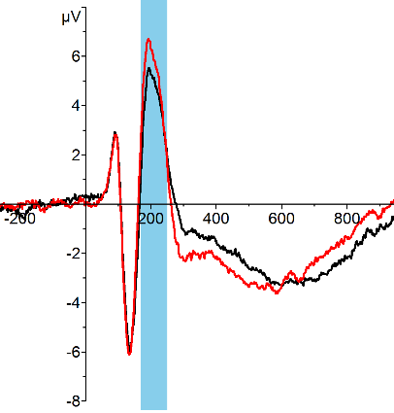
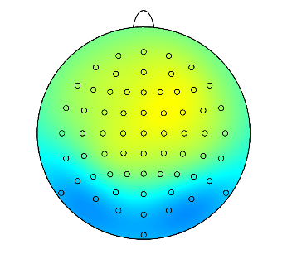
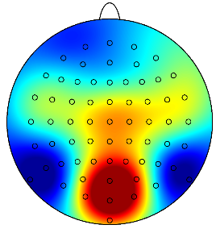
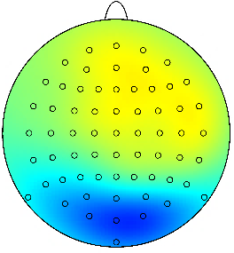
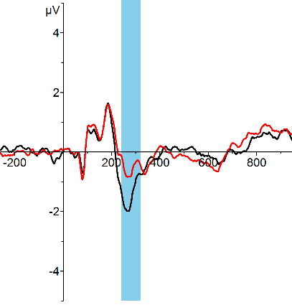
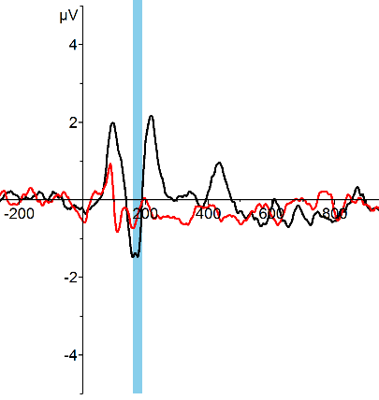
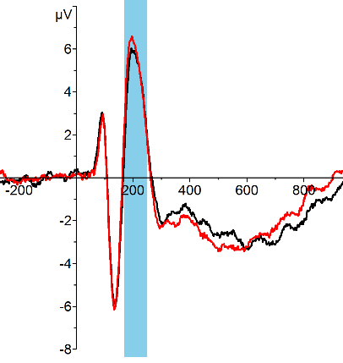
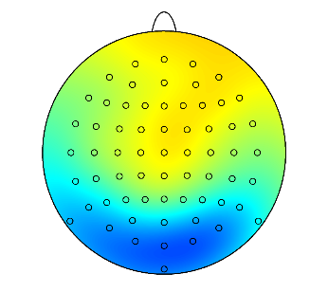
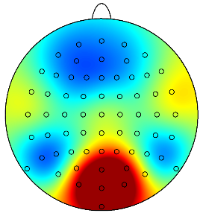
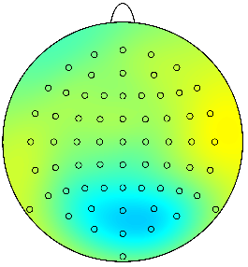
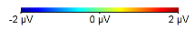
VAN
Dichoptic Color Fusion
Masking
Inattentional Blindness
Visible
Invisible
Pooled channels
*
Faces
*
*
*
*
*
*
*
*
*
*
*
*
*
*
*
*
*
*
*
*
*
*
*
*
*
*
*
*
*
*
*
*
*
*
Houses
*
*
*
*
*
*
*
*
*
*
*
*
*
*
*
*
*
*
*
*
*
*
*
*
*
*
*
*
*
*
*
*
*
*

Slide 2
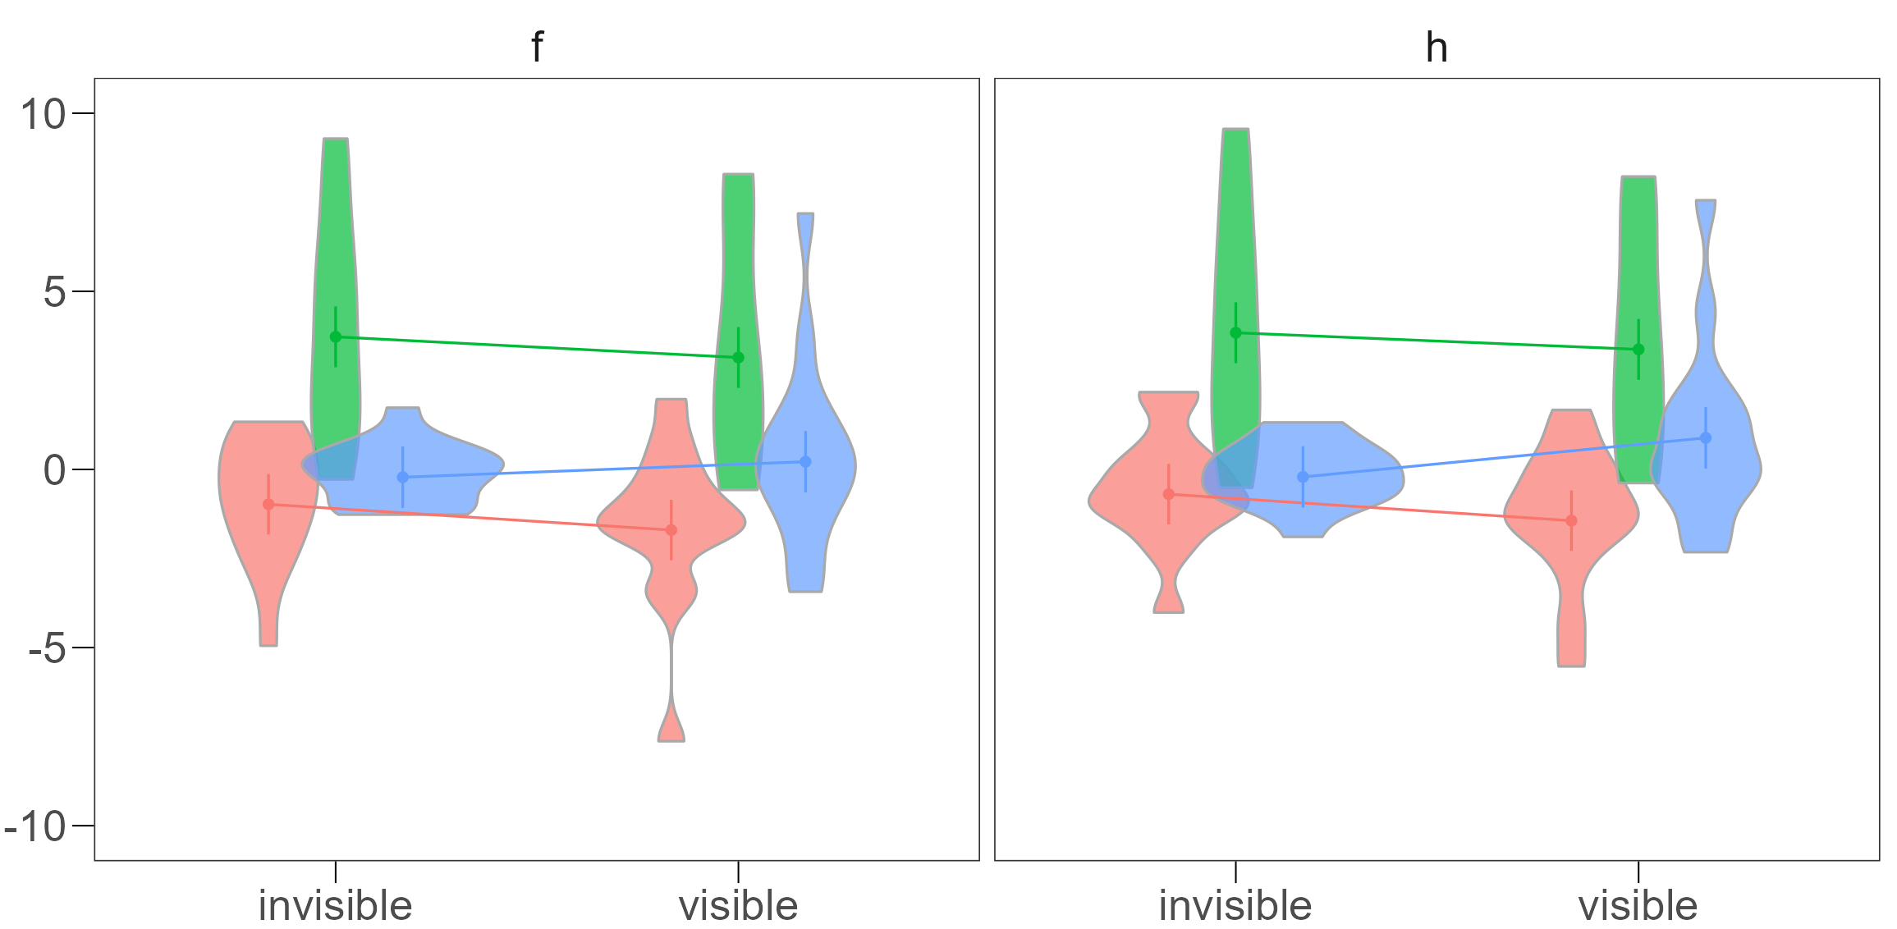
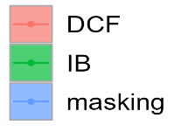
Faces
Houses
Voltage [µv]
DCF
IB
Masking
Invisible
Visible
Invisible
Visible

Slide 3
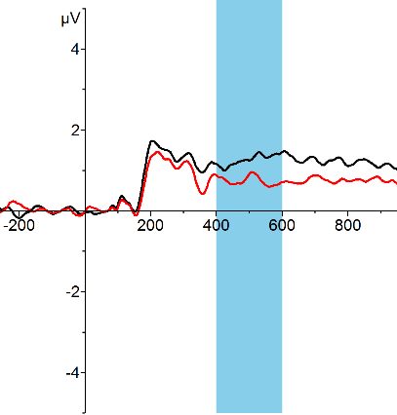
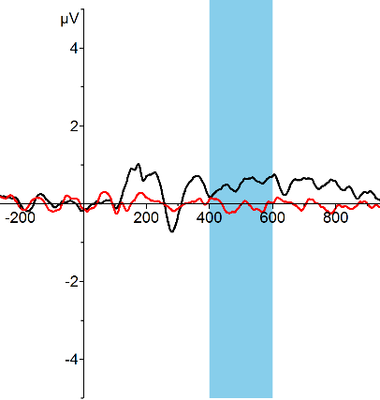
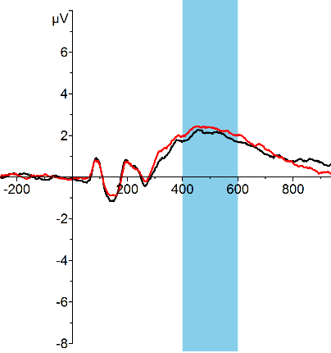
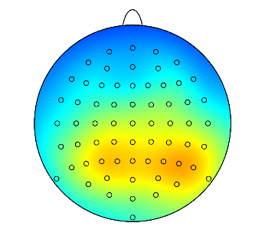
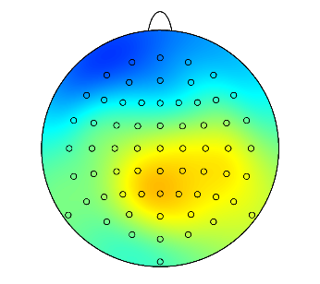
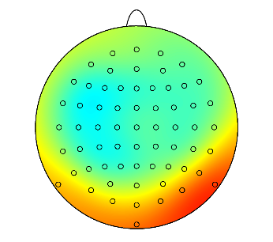
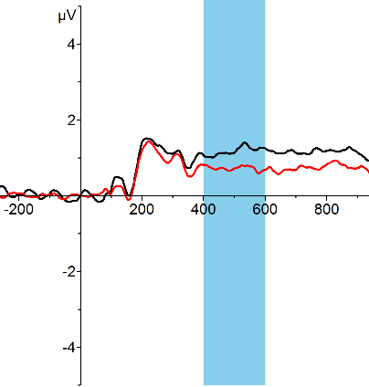
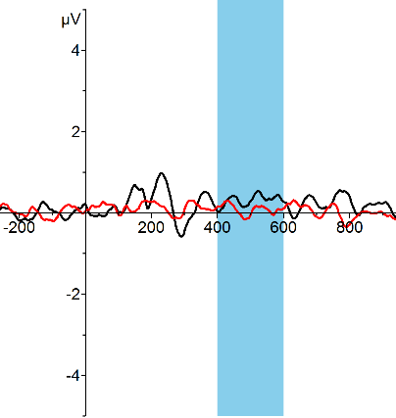

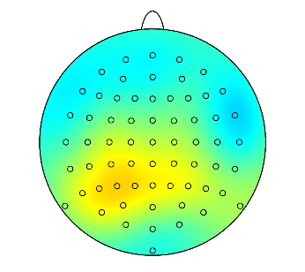
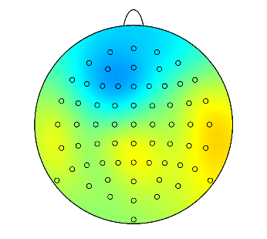
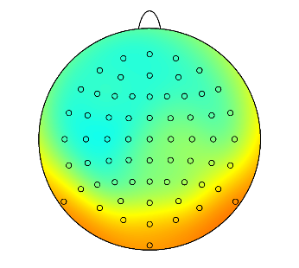
P3b
Dichoptic Color Fusion
Masking
Inattentional Blindness
Visible
Invisible
Pooled channels
*
Faces
*
*
*
*
*
*
*
*
*
*
*
*
*
*
*
*
*
*
*
*
*
*
*
*
*
*
*
*
*
*
*
*
*
*
*
*
*
*
*
*
*
*
*
*
*
Houses
*
*
*
*
*
*
*
*
*
*
*
*
*
*
*
*
*
*
*
*
*
*
*
*
*
*
*
*
*
*
*
*
*
*
*
*
*
*
*
*
*
*
*
*
*

Slide 4

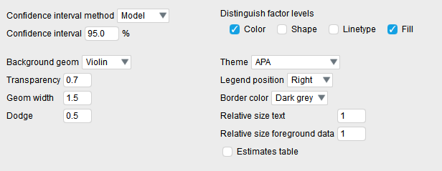
Faces
Houses
DCF
IB
Masking
Voltage [µv]
Invisible
Visible
Invisible
Visible

Slide 5
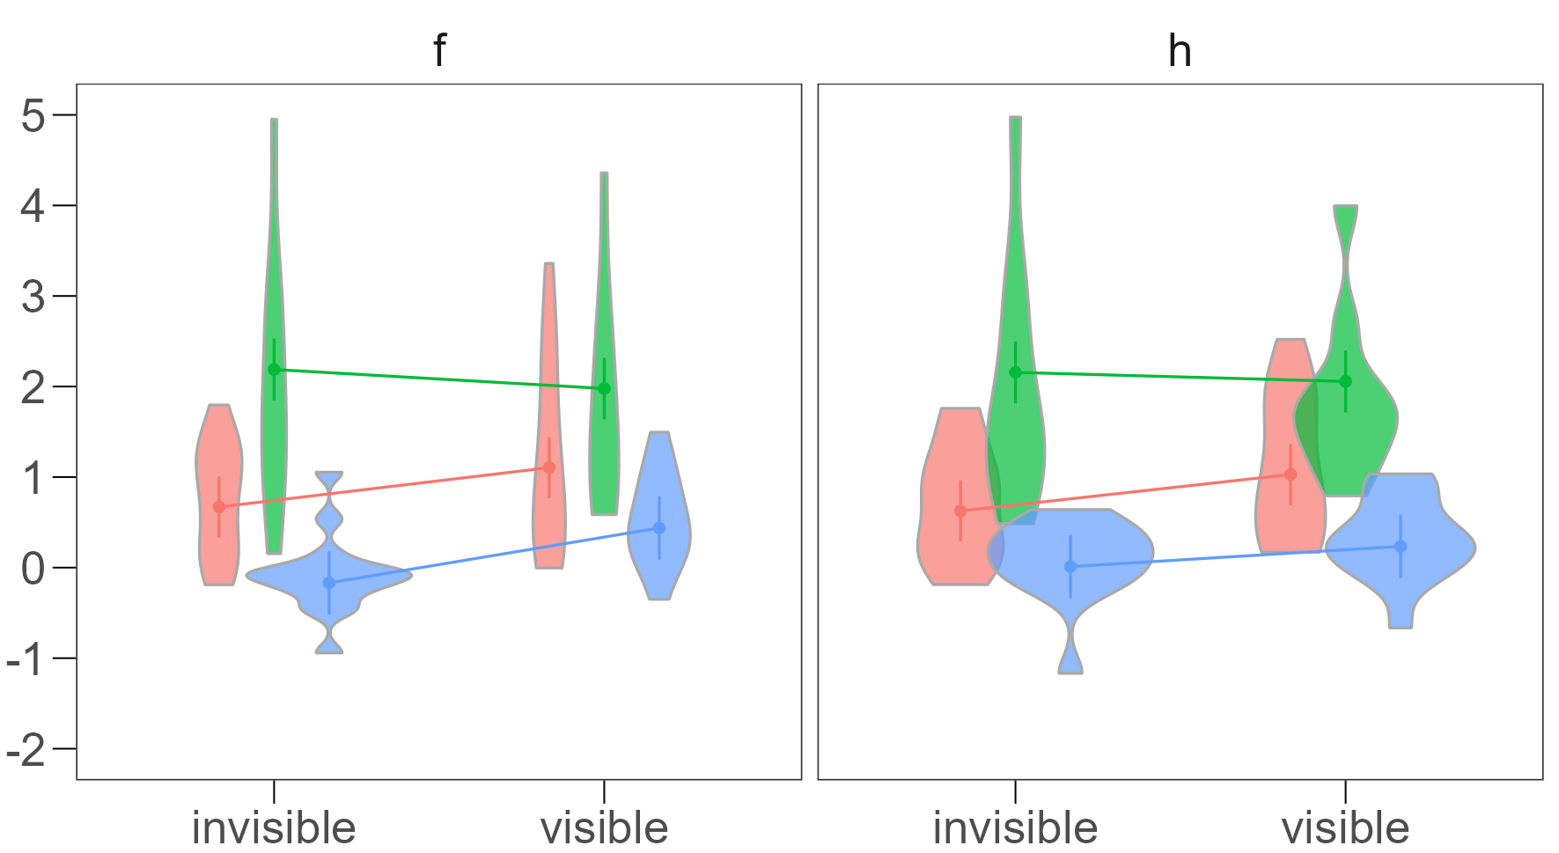
Faces
Houses
Voltage [µv]
DCF
IB
Masking
Invisible
Visible
Invisible
Visible

Slide 6
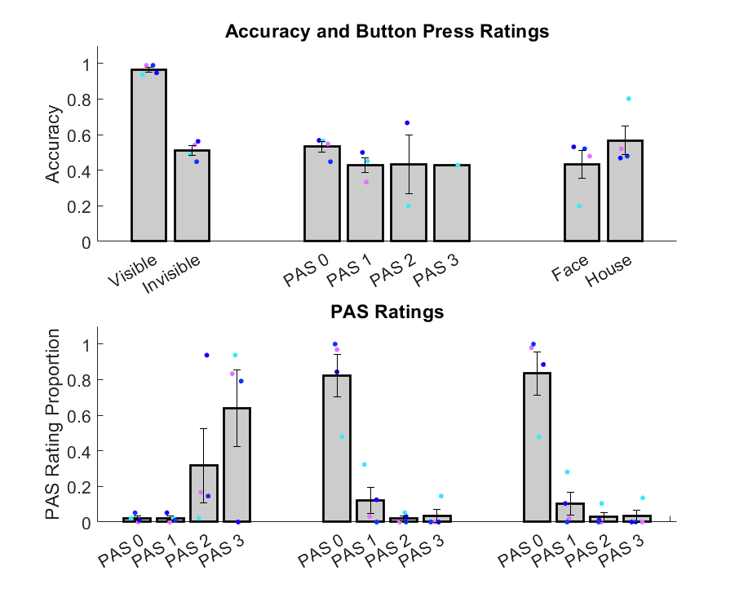
Button Press Ratings
Invisible
Blank
Visible
Invisible
Blank

Slide 7
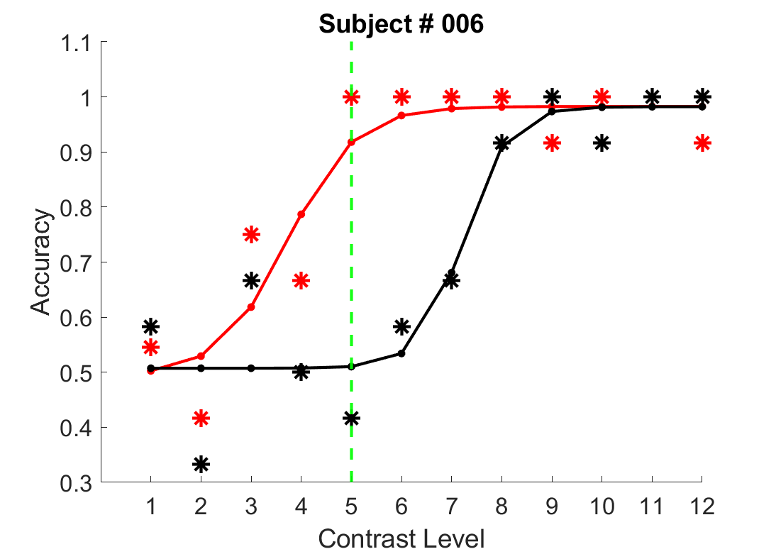
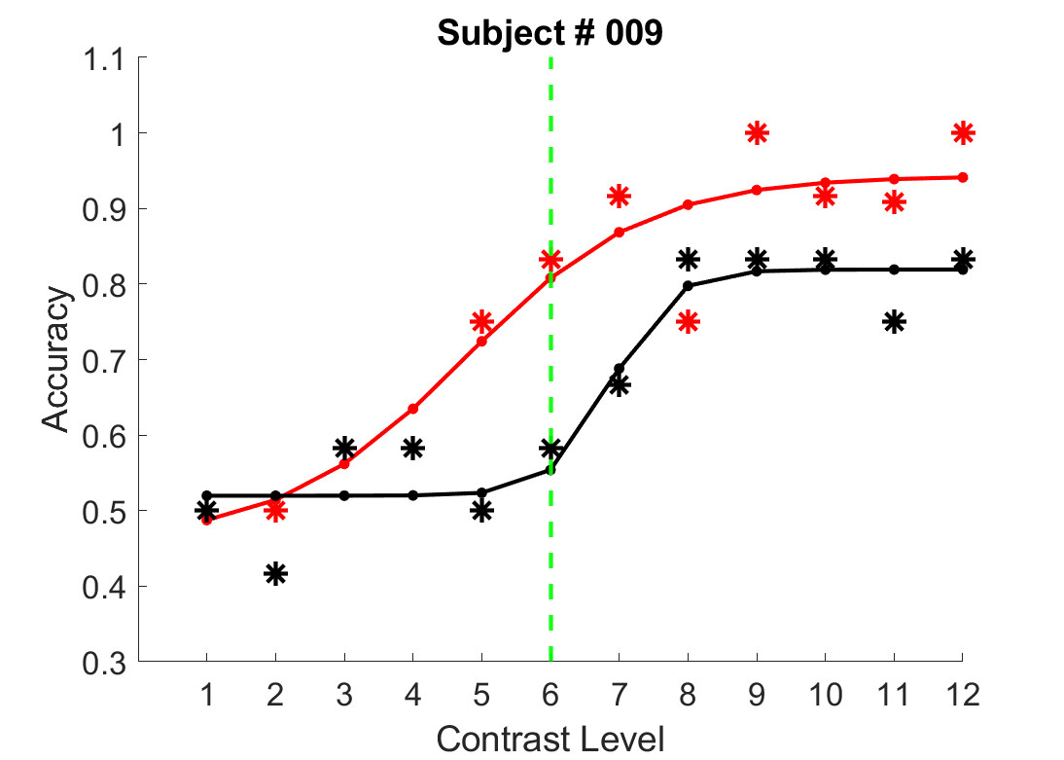
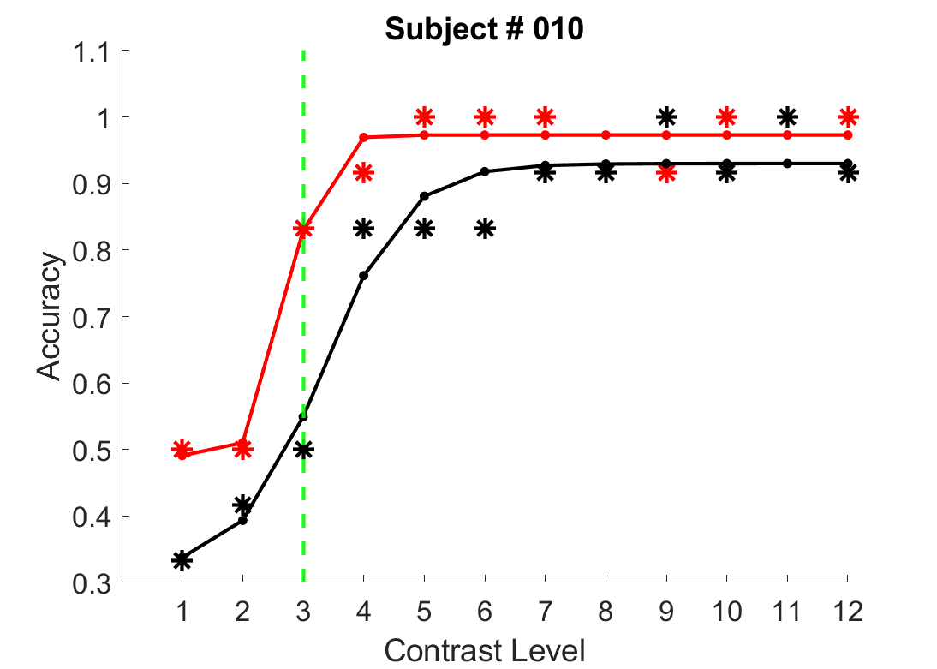
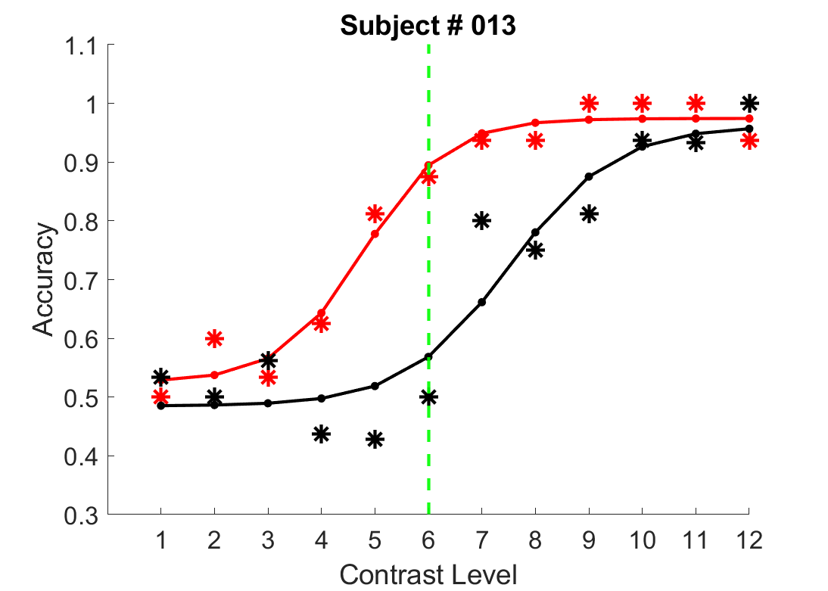

Slide 8
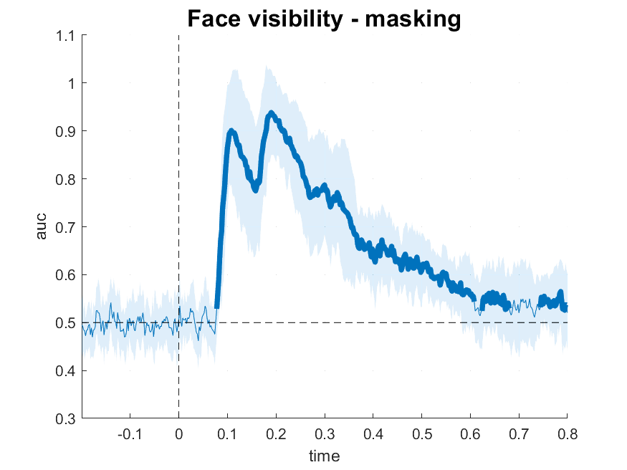
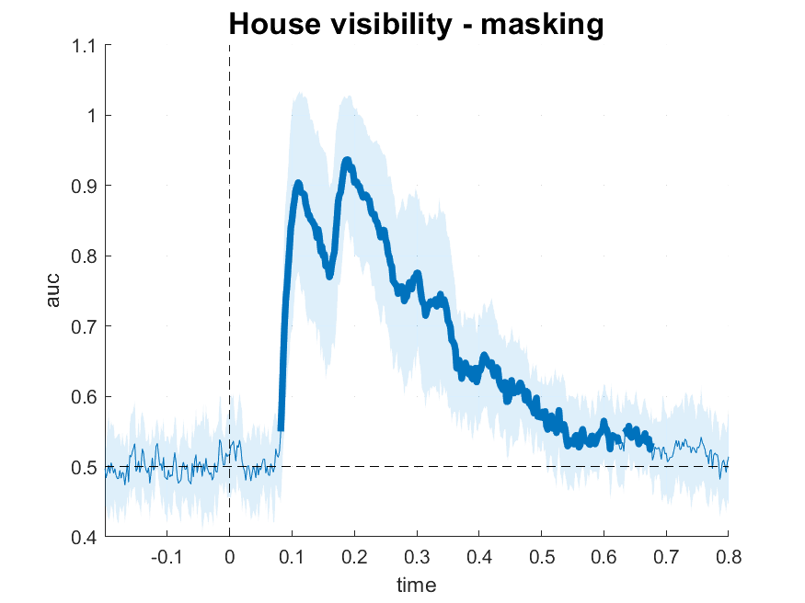
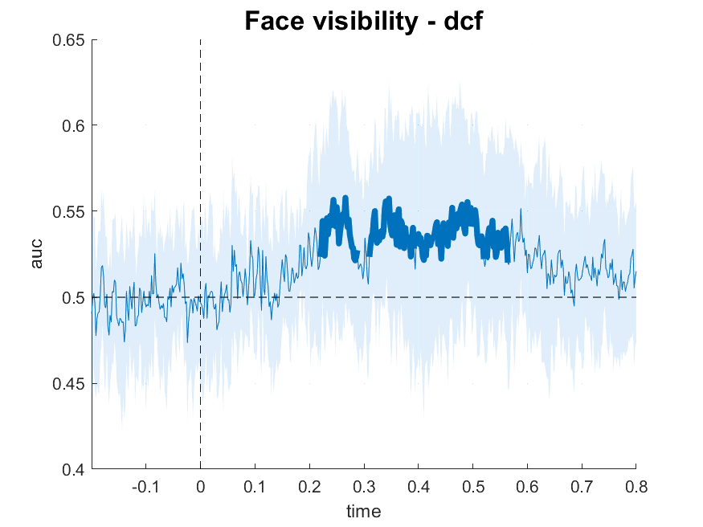
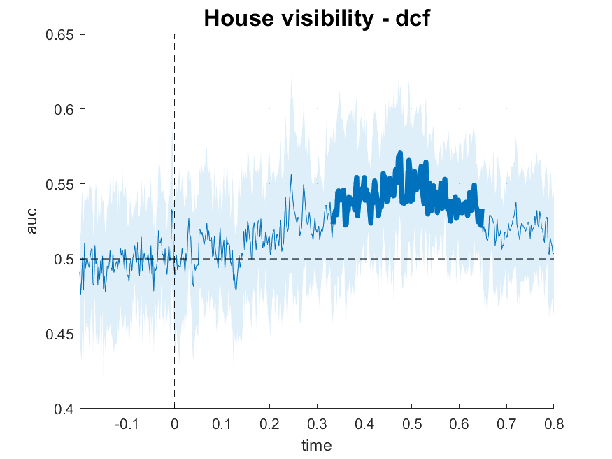
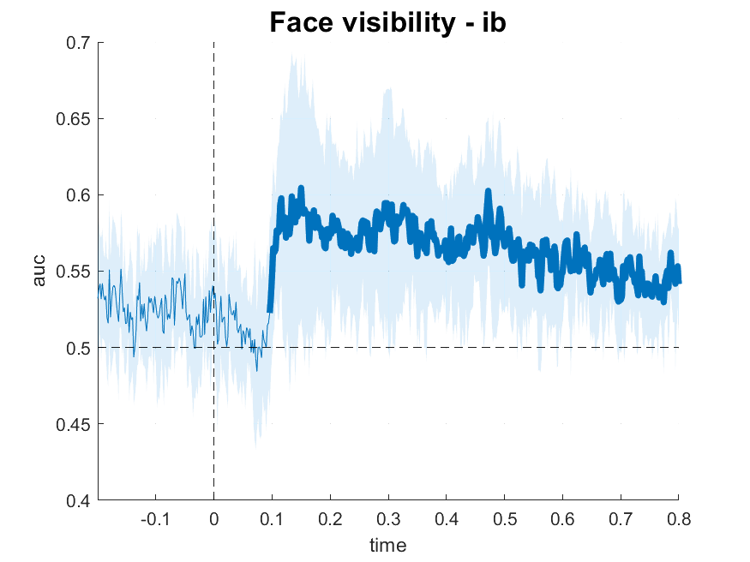
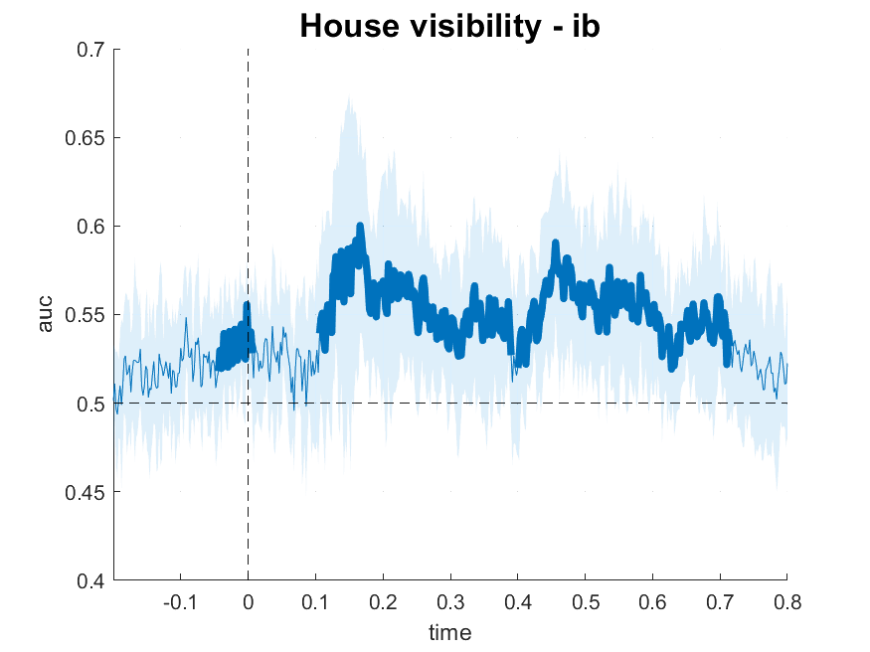
Face visibility - Masking
House visibility - Masking
AUC
AUC
Time [s]
Time [s]
Face visibility - DCF
House visibility - DCF
AUC
AUC
Time [s]
Time [s]
Face visibility - IB
House visibility - IB
AUC
AUC
Time [s]
Time [s]

Slide 9
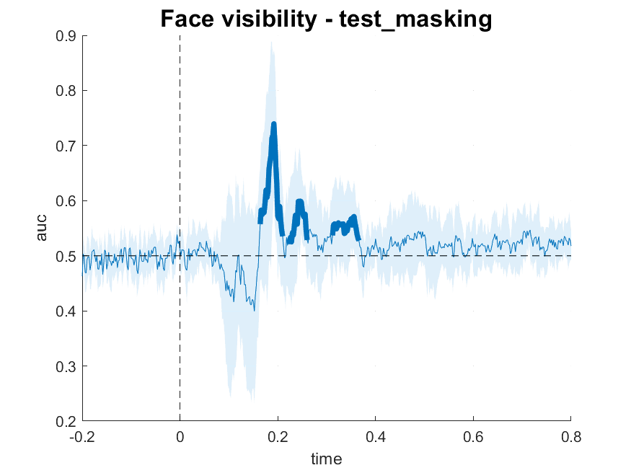
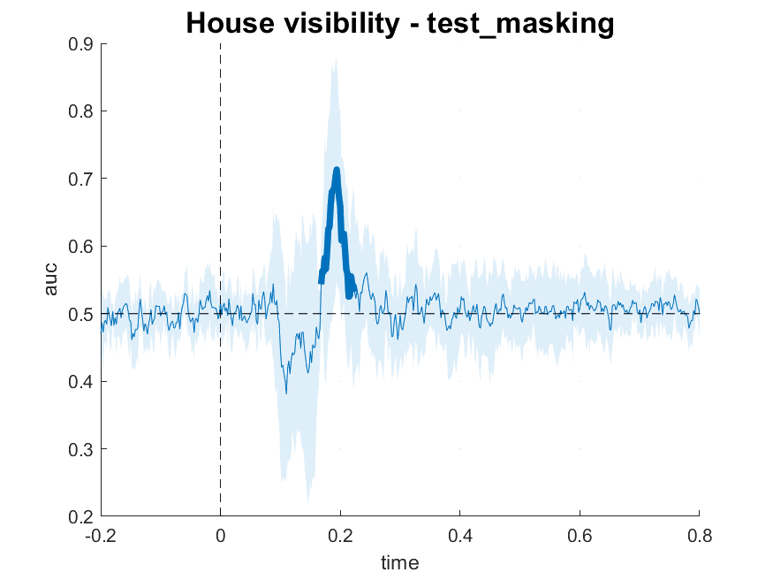
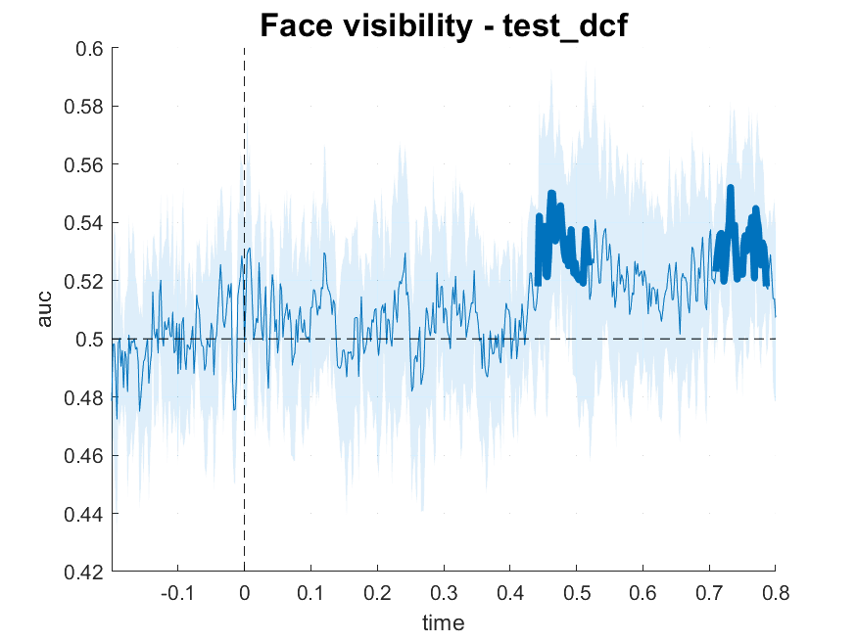
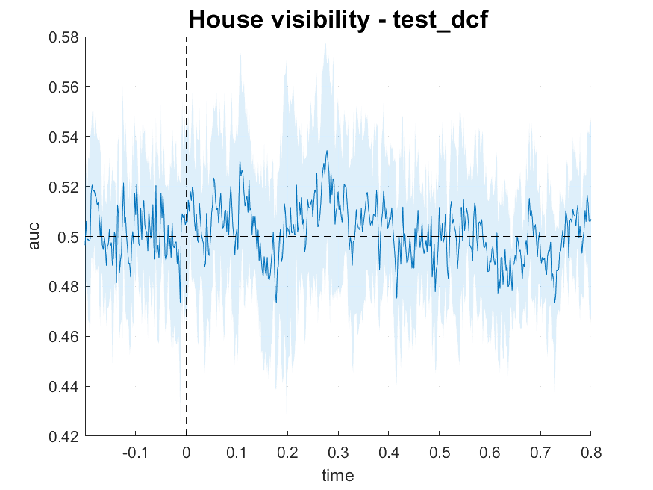
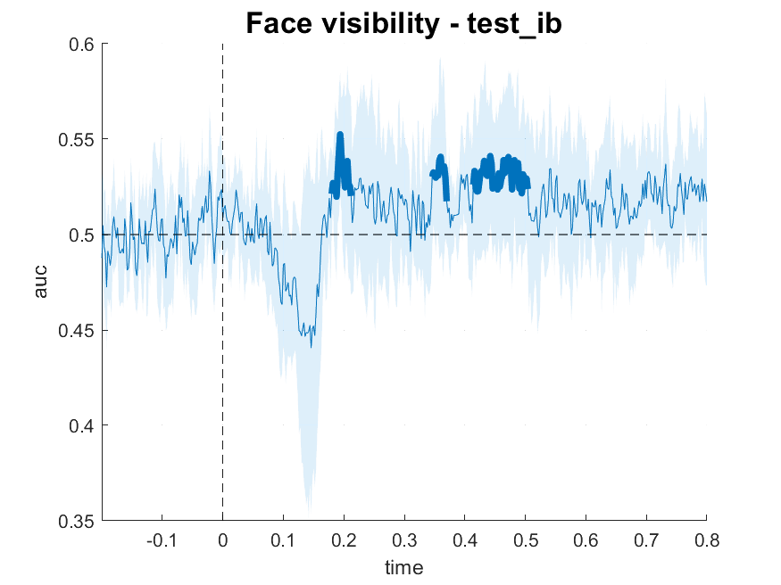
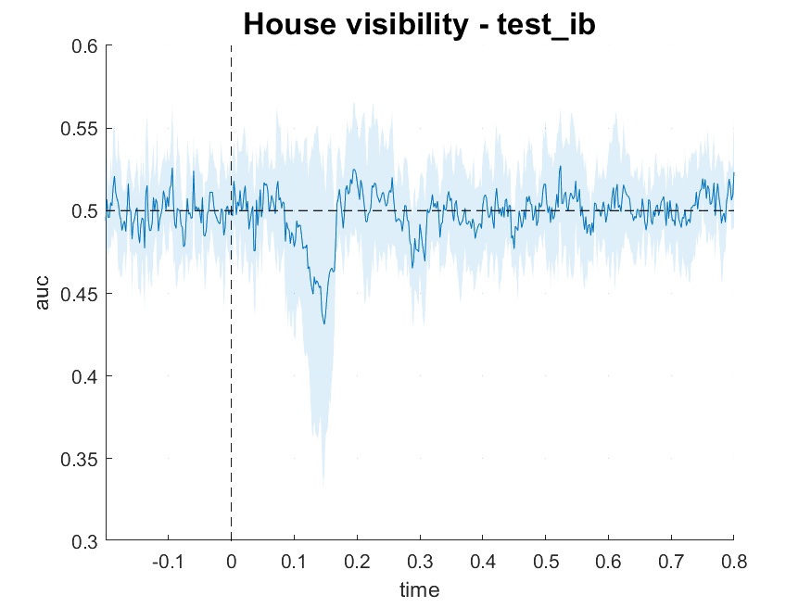
Face visibility – Test On Masking
House visibility – Test On Masking
AUC
AUC
Time [s]
Time [s]
Face visibility – Test On DCF
House visibility - Test On DCF
AUC
AUC
Time [s]
Time [s]
Face visibility - Test On IB
House visibility - Test On IB
AUC
AUC
Time [s]
Time [s]

